Slide 1
Love Our Constitution | February 2018
Notes:
THIS IS THE TITLE SLIDE. You can adjust the point size of the Presentation Name and Date to fit content.

Slide 2
Agenda
The U.S. Constitution: Three Branches of Government
Article I: Congress
Article II: Executive
Article III: Judiciary
Focus on Article III: The Federal Judiciary & Judicial Nominations
Federal Judiciary
Judicial Nominations
Lower Courts

Slide 3
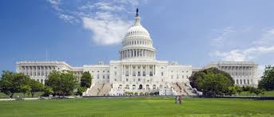
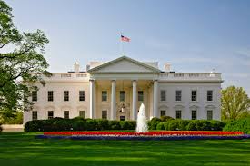
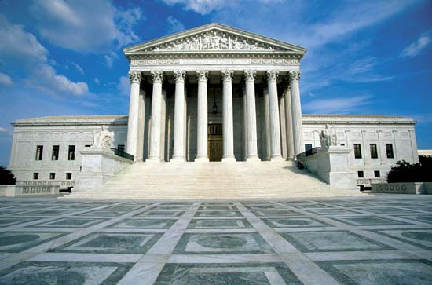
The U.S. Constitution
Article I: Legislative Branch
Designers
Article II: Executive Branch
Article III: Judicial Branch
Implementers
Enforcers
Interpreters
Notes:
resolves crucial questions about how our government operates
provides general framework
intentionally broad

Slide 4
Article III: Judiciary
Sec. 1
Judicial Power Vested
Sec. 2
Scope of Judicial Power
Sec. 3
Treason
Notes:
Article III is the shortest Article and only includes three sections.

Slide 5
Article III: Judiciary
U.S. Constitution
Article III, Section I
The judicial power of the United States, shall be vested in one Supreme Court, and in such inferior courts as the Congress may from time to time ordain and establish. The judges, both of the supreme and inferior courts, shall hold their offices during good behaviour, and shall, at stated times, receive for their services, a compensation, which shall not be diminished during their continuance in office.
Notes:
Article III judges hold their offices during good behavior which has meant that they have lifetime appointments.
Note: there is a debate among some scholars whether federal judges should have terms instead of lifetime appointments. Is this something the Founders would have considered?
The Constitution establishes one Supreme Court, but says “Congress may from time to time ordain and establish” lower courts. Congress has passed legislation to create many lower level courts – known as U.S. District and Circuit Courts of Appeals.
Who can serve on the court(s)
Eligibility: none outlined – no age minimum, no education requirements, etc.

Slide 6
Article III: Judiciary
Federalist Papers, No. 78
The Executive not only dispenses the honors, but holds the sword of the community. The legislature not only commands the purse, but prescribes the rules by which the duties and rights of every citizen are to be regulated. The judiciary, on the contrary, has no influence over either the sword or the purse; no direction either of the strength or of the wealth of the society; and can take no active resolution whatever. It may truly be said to have neither FORCE nor WILL, but merely judgment; and must ultimately depend upon the aid of the executive arm even for the efficacy of its judgments.
Notes:
OPTIONAL SLIDE: The Founders wrote that for courts have any legitimacy, the public must have trust in it. Congress can control funding, the President executes, and the Courts must rely on the public confidence to operate.

Slide 7
Article III: Judiciary
Judicial Independence
Appointment Process
Lifetime Appointment
“The standard of good behavior for the continuance in office of the judicial magistracy, is certainly one of the most valuable of the modern improvements in the practice of government. ... [I]n a republic it is a no less excellent barrier to the encroachments and oppressions of the representative body. And it is the best expedient which can be devised in any government, to secure a steady, upright, and impartial administration of the laws.”
- Federalist Paper No. 78
Notes:
There are two ways in which the Founders considered mechanisms for the judicial branch to be independent.
The first is through the Appointment/Nominations process – meaning that the President is checked by the Senate (which will be discussed more later).
The second is through the lifetime appointment since judges would not likely be as fearful of retribution for unpopular decisions.

Slide 8
Focus on Article III: The Federal Judiciary
National Discourse
U.S. Supreme Court
U.S. Circuit Courts of Appeal
U.S. District Courts
Examples of Recent and Pending Cases in Federal Courts
Notes:
Note to presenter: Identify which district court has jurisdiction over the regions in which the audience members reside.

Slide 9
Examples of Recent & Pending Cases in Federal Courts
Muslim Ban
Hawaii v. Trump (D. Haw. 2017)
Environmental Protections
Clean Air Council v. Pruitt (D.C. Cir. 2017)
Reproductive Health Care Access
Garza (on behalf of Jane Doe) v. Hargan (D.C. Cir. 2017)

Slide 10
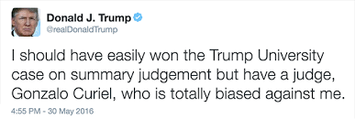
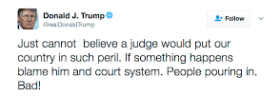
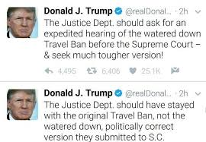
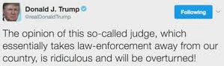
Focus on the Federal Judiciary
The President’s statements about judges and the judiciary have raised concerns about his commitment to core constitutional values and rule of law.
Notes:
The President has certainly interjected conversation about judges and the judiciary in his own comments.
Throughout his campaign and since his election, the President repeatedly emphasized that his Supreme Court nominee would be the most conservative jurist he could find, and he made sure his nominee passed a series of litmus tests, including on reproductive rights and gun safety laws.
And yet, we have a President who is undermining and attacking the courts.
Judge Gonzalo Curiel, who presided over a case involving Trump University, was called a “total disgrace” because he was a Mexican-American. Judge James Robart, who halted Trump’s Muslim ban, was labelled a “so-called judge.”
Attorney General Sessions also piled on when he said “I really am amazed that a judge sitting on an island in the Pacific can issue an order that stops the president of the United States from what appears to be clearly his statutory and constitutional power.”

Slide 11
Focus on the Federal Judiciary
Supreme Court
More than 10,000 petitions submitted annually
U.S. Circuit Courts of Appeals
U.S. District Courts
Hears only 75-80 cases
Receive more than 55,600 filings annually
Receive more than 390,500 filings annually

Slide 12
Focus on the Federal Judiciary
Standing: Justice Elena Kagan, Justice Samuel Alito, Justice Sonia Sotomayor, Justice Neil Gorsuch
Seated: Justice Ruth Bader Ginsburg, Justice Anthony Kennedy,
Chief Justice John Roberts, Justice Clarence Thomas, Justice Stephen Breyer
Notes:
There are nine members of the Supreme Court of the United States, all of whom were nominated by a U.S. President and confirmed by the U.S. Senate.

Slide 13
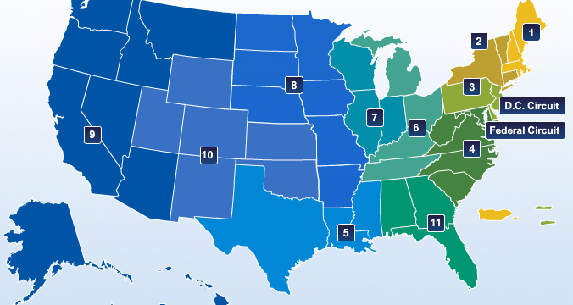
Focus on the Federal Judiciary
U.S. Circuit Courts of Appeal
179 Courts of Appeals Judgeships Authorized
Notes:
Note to presenter: point out what circuit court has jurisdiction over matters from the state in which the audience members reside.

Slide 14
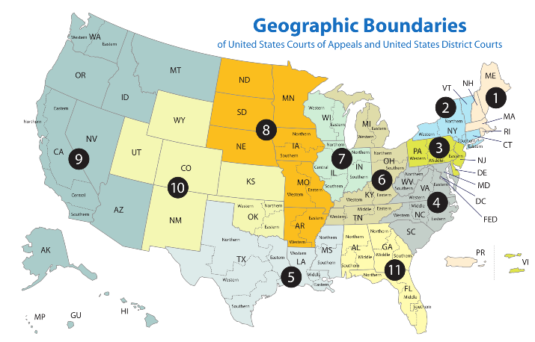
Focus on the Federal Judiciary
U.S. District Courts
673 District Court Judgeships Authorized
Notes:
Note to presenter: point out what circuit court has jurisdiction over matters from the state in which the audience members reside.

Slide 15
Judicial Nominations
How Do Judges Become Judges?
Article II (Executive), Section 2
The President…shall nominate, and by and with the advice and consent of the Senate, shall appoint ambassadors, other public ministers and consuls, judges of the Supreme Court, and all other officers of the United States, whose appointments are not herein otherwise provided for, and which shall be established by law….
Notes:
President nominates – with the advice and consent of the Senate.
This only specifies the Supreme Court judges, but Congress has “established by law” other “Article III” judgeships at the District and Circuit Court levels.

Slide 16
Judicial Nominations
The search for a new judge begins when there is a vacancy.
A judicial vacancy arises when a judge retires, takes senior status, is elevated, or otherwise leaves office.

Slide 17
Judicial Nominations
Federal Judicial Nominations Process
Judicial Vacancy Announced
Step 1: President Nominates
Step 2: Senate Judiciary Committee Evaluates
Step 3: Senate Judiciary Committee Reports
Step 4: Senate Confirmation Vote
Notes:
There are no time limits at any point of the process.
Given the multiple factors and activities that feed into each of these phases, there are many opportunities for input and significant delays to occur.

Slide 18
Judicial Nominations
How Does Advice & Consent Happen?
Rule Examples
Norms
Pre-Nomination: Senator Selection, Consultation
Cloture & Filibuster Rules
Post-Nomination: Blue Slips, Committee Review, Hearings, Committee Vote, Senate Vote
Number of hours for debate

Slide 19
Judicial Nominations
Step 1: President Nominates
For District & Circuit Court Vacancies: Home-State Senators
Senators have a selection process to provide important community input, many use merit-based selection commissions
Sends recommendations to President
Judicial Vacancy Announced
Step 1: President Nominates
Step 2: Senate Judiciary Committee Evaluates
Step 3: Senate Judiciary Committee Reports
Step 4: Senate Confirmation Vote
Notes:
For U.S. Supreme Court Nominees:
The President has full autonomy in naming Supreme Court nominees. S/he may confer with others, but as the justices do not reside in a particular state while serving on the bench, there is not much role for a “home state senator” in the selection process.
For Circuit Court Nominees:
Typically, the President has more autonomy in naming Circuit Court nominees. Often, though, s/he will welcome suggestions from Senators, especially when the Circuit Court seat falls in that Senator(s)’ home state.
For District Court Nominees:
When both Senators are of the President’s party: they can share the role of recommending judicial candidates or one can take a lead role.
When neither Senator is of the President’s party: Senators then usually play a secondary role, with the primary role played by another official (Representative, Governor, etc.) who will take the lead.
When one Senator is of the President’s party: This Senator is usually the lead senator and expected to play a significant role in identifying candidates for the President to consider.

Slide 20
Judicial Nominations
Step 1: President Nominates
For All Vacancies: Vetting & Investigation
White House Counsel & U.S. Department of Justice Office of Legal Policy
American Bar Association (ABA) Standing Committee on the Federal Judiciary Review*
Most administrations allow the ABA to simultaneously conduct a confidential review to declare nominees well-qualified, qualified, or not qualified.
The only modern administrations to not do so are the Trump and G.W. Bush Administrations.
Public Announcement
Judicial Vacancy Announced
Step 1: President Nominates
Step 2: Senate Judiciary Committee Evaluates
Step 3: Senate Judiciary Committee Reports
Step 4: Senate Confirmation Vote
Notes:
For U.S. Supreme Court Nominees:
The President has full autonomy in naming Supreme Court nominees. S/he may confer with others, but as the justices do not reside in a particular state while serving on the bench, there is not much role for a “home state senator” in the selection process.
For Circuit Court Nominees:
Typically, the President has more autonomy in naming Circuit Court nominees. Often, though, s/he will welcome suggestions from Senators, especially when the Circuit Court seat falls in that Senator(s)’ home state.
For District Court Nominees:
When both Senators are of the President’s party: they can share the role of recommending judicial candidates or one can take a lead role.
When neither Senator is of the President’s party: Senators then usually play a secondary role, with the primary role played by another official (Representative, Governor, etc.) who will take the lead.
When one Senator is of the President’s party: This Senator is usually the lead senator and expected to play a significant role in identifying candidates for the President to consider.

Slide 21
Judicial Nominations
Step 2: Senate Judiciary Committee Evaluates
Nominees submit a Senate Judiciary Committee Questionnaire
Committee staff and members may conduct further background research
Judicial Vacancy Announced
Step 1: President Nominates
Step 2: Senate Judiciary Committee Evaluates
Step 3: Senate Judiciary Committee Reports
Step 4: Senate Confirmation Vote
Notes:
Senate Judiciary Committee Questionnaire contains questions and requests for information such as:
Complete employment history
List of all professional, business, fraternal, scholarly, civic, charitable, or organizations in which the nominee has been a member since graduation from law school
List and copies of all published writings and public statements
Judicial offices held (if so, 10 most significant cases presided over)
Identification of any public offices held, unsuccessful candidacies for elective office, or role played in a policy campaign
Description of 10 most significant litigated matters s/he personally handled
Teaching experience
Financial statements
Conflicts of interest
They review the White House, Department of Justice, and FBI background documents.
The ABA has a Standing Committee on the Federal Judiciary which provides formal notification of a nominee’s rating. Ratings include “well qualified,” “qualified,” or “not qualified.” Though rare, if the ABA unanimously or by majority rates a nominee as “not qualified,” they will submit a written statement to the Committee explaining the rating (usually 48 hours in advance of the nominee’s confirmation hearing, at which the chair of the ABA Committee will testify to explain and answer questions).
These ratings do not need to be unanimous, and if not, a letter will note if that rating was determined by a “majority” or “substantial majority” of the committee members.
Ratings are publicly available: http://www.americanbar.org/groups/committees/federal_judiciary.html

Slide 22
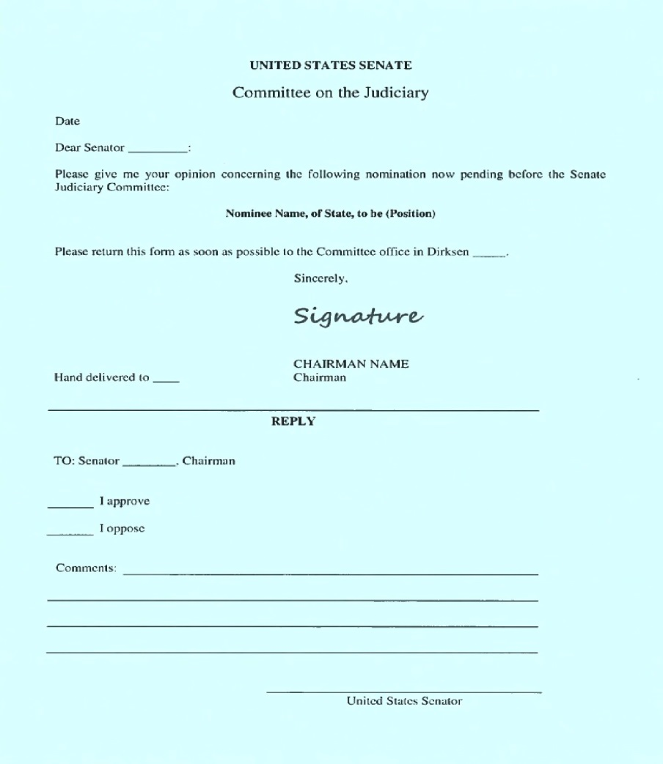
Judicial Nominations
Step 2: Blue Slips
Notes:
For lower court nominations, the Senate Judiciary Committee maintains a “blue slip” policy. This policy means that a senator, regardless of his/her party affiliation, is provided the courtesy of submitting a “blue slip” to signal support of a nominee from his/her state.
A senator opposed to a particular judicial nominee from her/his home state may decline to return a positive blue slip to the Committee or s/he may return a negative blue slip which would block the nominee from receiving a committee hearing or vote.
As part of fostering the “advice and consent” of the Senate, this policy tends to promote early consultation between the White House and the nominees’ home-state senators.

Slide 23
Judicial Nominations
Step 2: Senate Judiciary Committee Hearing
Questions from Senate Judiciary Committee members
Written questions for the record
Judicial Vacancy Announced
Step 1: President Nominates
Step 2: Senate Judiciary Committee Evaluates
Step 3: Senate Judiciary Committee Reports
Step 4: Senate Confirmation Vote
Notes:
Hearings are not required, but are at the discretion of the Senate Judiciary Committee Chair. It is common practice, however, that the Committee will not vote on a circuit or district court nominee without having held a hearing. Failure to schedule a hearing is usually due to 1) failure of home-state senators to submit her/his blue slip or 2) lack of time in the congressional session.
Question & Answer Session:
For district and lower court nominees, these hearings are often held with more than one nominee at a time.
If members have concerns about a nominee, that nominee may have her/his own hearing, be questioned more intensively, and/or more senators may attend the hearing to ask questions. Rarely, the Committee will hold hearings on more than one day.
Public Witnesses:
Typically, these are written letters submitted to the Committee.
Letters are often submitted from local or state bar associations or interest groups opposed to or supportive of the nominee
Rarely, public witnesses may testify at the hearing (usually if the ABA rated the nominee not qualified or other if the nominee is highly controversial)
Questions for the Record:
District and Circuit Court nominees may be required to answer follow-up questions from senators on the Committee.
Responses to these questions are required before the Committee will consider whether to report the nomination to the full Senate.

Slide 24
Judicial Nominations
Step 3: Senate Judiciary Committee Reports
Notes:
Before the Senate Judiciary Committee can send the nomination to the full Senate for a vote, they meet in Executive Business Meeting to decide how to report out the nominee.
Whether and when to schedule this Committee vote is in the discretion of the Committee chair. Nominees scheduled for a vote are listed in the agenda for the Committee’s next Executive Business Meeting. A sufficient number of members must be present at the meeting, and if there are enough senators at the meeting, they can move or ask for unanimous consent that the nominees listed on the agenda individually or as a group be reported to the Senate.

Slide 25
Judicial Nominations
Step 3: Committee Reports Nominee Out
Committee can report out to the nomination to the full Senate in any of these ways:
Favorable
Unfavorable
Without Recommendation
Rejection
Judicial Vacancy Announced
Step 1: President Nominates
Step 2: Senate Judiciary Committee Evaluates
Step 3: Senate Judiciary Committee Reports
Step 4: Senate Confirmation Vote
Notes:
Favorable: Committee will report out of Committee the nominee and the full Senate will then be able to consider her/his nomination.
Unfavorable or Without Recommendation: Rare, this report out of Committee will still advance the nominee for full Senate consideration even though the nominee lacks majority support from the Committee.
Rejection: VERY rare, but a majority of the Committee can vote to reject that the nominee be reported out of Committee.
Voice Vote or Roll Call votes may be made.
A nomination is most likely “to die” or fail in Committee due to failure to receive any Committee action (hearing, report out).

Slide 26
Judicial Nominations
Step 4: Senate Floor
Executive Calendar
Confirmation Vote
Judicial Vacancy Announced
Step 1: President Nominates
Step 2: Senate Judiciary Committee Evaluates
Step 3: Senate Judiciary Committee Reports
Step 4: Senate Confirmation Vote
Notes:
Business listed in the Executive Calendar must be conducted when the Senate is in executive session (usually done by motion or unanimous consent motion to the Senate majority leader). The nomination cannot be taken up until it has been on the Executive Calendar at least one calendar day.
2 procedural tracks for Senate floor consideration:
Unanimous consent agreements: the Senate by unanimous consent takes up nominations for floor consideration and arranges for them to receive up-or-down confirmation votes or be confirmed by unanimous consent. This is the typical path for noncontroversial nominees.
Cloture votes: when unanimous consent cannot be reached, the Senate must vote on a cloture motion to bring floor debate to a close, which, if a majority agrees, a confirmation vote on the nomination must be held after a period of consideration.
The rule used to require 3/5th of the Senate to agree, and now it is a simple majority for district, circuit, and Supreme Court nominations.
Can confirm by unanimous consent, voice vote, or roll call vote.

Slide 27
Judicial Nominations
After Confirmation
President Signs Commission
Oath of Office
Investiture
Notes:
Commission is a formal document empowering the nominee to assume that judicial office
The Department of Justice sends the new judge the commission, other forms, and the oath of office, which each judge must take before exercising judicial authority.
Oath of office can be administered by anyone legally authorized to do so, including the chief judge, other judge on the court, home state senator, etc.
Investiture is the last step, a ceremonial event where the new judge is sworn in in the courtroom. This is not required to happen before the nominee assumes office.

Slide 28
Lower Courts
Nearly 20% of federal judgeships are currently vacant or will be soon!
As of January 17, 2018, there are:
139 Current Vacancies
24 Known Future Vacancies
72 Judicial Emergencies

Slide 29
Lower Courts
Why So Many Vacancies?
The Senate Republican Majority refused to consider Chief Judge Merrick Garland’s nomination to the U.S. Supreme Court.
They also refused to process nominees to fill more than 100 lower court vacancies.
During President Obama’s final 2 years, the Senate Republican Majority confirmed the fewest number of judges (22 in 2 years) since the Eisenhower Administration.

Slide 30
Lower Courts
How is President Trump Doing?
23 Confirmations
1 Supreme Court Justice
43 Pending Nominations
7 Circuit Court Nominees
36 District Court Nominees
120 More Vacancies Waiting for Nominees
16 Circuit Court Vacancies
12 Circuit Court of Appeals Judges
10 District Court Judges
102 District Court Vacancies
2 Court of International Trade Vacancies
As of January 12, 2018

Slide 31
Article III (Lifetime) Confirmations and Nominations in the First Year of Recent Administrations
 | Supreme Court Confirmations | Circuit Court Confirmations | District Court Confirmations | Total Confirmations | Total Nominations
Trump (2017) | 1 Gorsuch | 12 | 6 | 19 21% Women 11% POC 4 Women (3 Cir., 1 Dist.) 2 Men of Color (Cir.) | 69
Obama (2009) | 1 Sotomayor | 3 | 9 | 13 46% Women 54% POC 6 Women (1 Supreme, 5 Dist.) 5 Women of Color (1 Sup., 4 Dist.) 2 Men of Color (1 Cir.,1 Dist.) | 34
GW Bush (2001) | 0 | 4 | 8 | 28 29% Women 18% POC 8 Women (2 Cir., 6 Dist.) 2 Women of Color (Dist.) 3 Men of Color (2 Cir., 1 Dist.) | 66
Clinton (1993) | 1 RBG | 3 | 24 | 28 29% Women 25% POC 8 Women (1 Sup., 1 Cir., 6 Dist.) 1 Woman of Color(Dist.) 6 Men of Color (Dist.) | 48
GHW Bush (1989) | 0 | 4 | 10 | 14 21% Women 7% POC 3 Women (1 Cir., 2 Dist.) 1 Man of Color (Cir.) | 23
Reagan (1981) | 1 O’Connor | 8 | 32 | 41 5% Women 5% POC 2 Women (1 Sup., 1 Dist.) 2 Men of Color | 44

Slide 32
Lower Courts
Trends in Breakdown of Nominations Process
Holding open the Supreme Court seat for over a year
Lack of consultation with home-state Senators
White House refusal to allow the ABA Standing Committee on the Federal Judiciary to review nominees before nominees are officially nominated
Incomplete vetting of the nominee

Slide 33
Lower Courts
Trends in Breakdown of Nominations Process Cont’d
Senate Judiciary Committee Chair scheduling of hearings prior to the ABA Standing Committee review
Senate Judiciary Committee Chair scheduling of two Circuit Court nominees for the same hearing, providing little opportunity for thorough public questioning
Refusal by the Senate Judiciary Committee Chair to honor the blue slips and advice of home-state Senators

Slide 34
Lower Courts
Trends in Nominees
More Not Qualified Ratings from the ABA Standing Committee on Federal Judiciary
Young, Less Legal Experience
No Practice in the Level of Court to Which They’re Being Nominated
Strong Affiliations with Very Conservative Legal and Social Institutions
Very Controversial Writings, Blogs, Speeches

Slide 35
Lower Courts
President Trump’s Potential Supreme Court Nominees
Features: “Most Conservative” Jurist to Pass States Litmus Tests of Overturning Roe, Protecting Gun Ownership
Confirmed
Justice Neil Gorsuch, 10th Cir., Colo.: confirmed to U.S. Supreme Court
Judge Amul Thapar, E.D. Ky.: confirmed to 6th Cir., Ky.
Judge Allison Eid, Colorado Supreme Court: confirmed to 10th Cir., Colo.
Judge Joan Larsen, Michigan Supreme Court: confirmed to 6th Cir., Mich.
Justice Don Willett, Texas Supreme Court: nominated to 5th Cir., Tex.
Judge Amy Coney Barrett, Notre Dame Law Professor: Confirmed to the 7th Cir., Ind.
Judge Kevin Newsom, Former Alabama Attorney General: Confirmed to the 11th Cir., Ala.
Justice David Stras, Minnesota Supreme Court: nominated to 8th Cir., Minn.
Nominated and Pending

Slide 36
Lower Courts
Supreme Court Shortlist Cont’d
Have Not Changed Positions
Justice Keith Blackwell, Georgia Supreme Court
Justice Charles Canady, Florida Supreme Court
Senator Ted Cruz, U.S. Senator (Tex.)
Justice Britt Grant, Georgia Supreme Court
Judge Raymond Gruender, 8th Cir., Mo.
Judge Thomas Hardiman, 3d., Cir., Pa.
Judge Brett Kavanaugh, D.C. Cir.
Judge Raymond Kethledge, 6th Cir., Mich.
Senator Mike Lee, U.S. Senator, Utah
Justice Thomas Lee, Utah Supreme Court
Justice Edward Mansfield, Iowa Supreme Court
Judge Federico Moreno, S.D. Fla.
Judge William Pryor, 11th Cir., Ala.
Judge Margaret Ryan, U.S. Ct. Apps. Armed Services
Judge Diane Sykes, 7th Cir., Wis.
Judge Tim Tymkovich, 10th Cir., Colo.
Justice Robert Young, Michigan Supreme Court
Justice Patrick Wyrick, Supreme Court of Oklahoma

Slide 37
Judging Potential Judges
What does the public expect of judges?
What would Senators want to know of potential nominees?
What are the ways you think Senators could select judges?
What communities should be involved in the process?
How much does representation of communities on the bench matter in the decision making process?
Notes:
Share one-pager on 5-4 decisions

Slide 38
Resources
Learn more about…
The American Constitution Society, constitutional issues and news: www.acslaw.org
Judicial vacancies and nominations: www.judicialnominations.org
Judicial nominees: www.afj.org/our-work/issues/judicial-selection
U.S. Constitution’s origins: constitutionalrights.constitutioncenter.org/
Other countries’ constitutions: www.constituteproject.org/
U.S. Courts (History, Authorizations, Judges, Vacancies, etc.): www.uscourts.gov
U.S. Senate Judiciary Committee: www.judiciary.senate.gov

Slide 39
Resources, Continued
Dahlia Lithwick, Lawyers Aren’t Wizards, Slate, July 21, 2017: http://www.slate.com/articles/news_and_politics/jurisprudence/2017/07/lawyers_and_the_constitution_alone_won_t_save_us_from_donald_trump.html
ACS National Conference Call Democracy at Risk with Sen. Chris Coons (D-Del.), December 7, 2017: https://www.acslaw.org/node/923820018
ACS DC Lawyer Chapter, Judicial Nominations Process, January 11, 2018: Judicial Nominations Process Event: https://www.c-span.org/video/?439587-1/judicial-nominations-process
ACS National Convention, Norms, Conventions, and Constitutional Governance, June 9, 2017: https://www.acslaw.org/news/video/acs-2017-national-convention-plenary-norms-conventions-and-constitutional-governance

Slide 40
Love Our Constitution
Notes:
THIS IS THE DIVIDER OR SUBTITLE SLIDE to use in between a series of slides

Slide 41
THANK YOU
Notes:
THIS IS A CLOSING SLIDE. For call to action, sign-off, contact information etc.

