Slide 1
Separation of Church and State and the U.S. Constitution Constitution in the Classroom
This lesson was prepared in collaboration with

Slide 2

What are lawyers for?
Notes:
Or another icebreaker question. This is a good transition for the volunteer to then shift to talk about their career and the education path for lawyers.

Slide 3

The U.S. Constitution separates government and religion.
Notes:
What is the Separation of Church and State?

Slide 4
U.S. Constitution – Bill of Rights
First Amendment: Congress shall make no law respecting an establishment of religion, or prohibiting the free exercise thereof; or abridging the freedom of speech, or of the press; or the right of the people peaceably to assemble, and to petition the Government for a redress of grievances
Notes:
Where does the separation of church and state come from? The U.S. Constitution!

Slide 5
Two Ways Church State Separation Is Guaranteed by the First Amendment
Establishment Clause: Congress shall make no law respecting an establishment of religion,
Free Exercise Clause: prohibiting the free exercise thereof;
Notes:
The Religion Clauses of the First Amendment

Slide 6
U.S. Constitution – First Amendment Establishment Clause
Congress shall make no law respecting an establishment of religion
The government cannot create an “established” (official or national) religion.
The government cannot sponsor religious activity, especially by directly paying for religious endeavors.
The government must be neutral toward religion and among religions in its laws and decision-making.
Notes:
LAYOUT OPTION 2 with photo on side. Use of icons as bullets, but centered

Slide 7
U.S. Constitution – First Amendment Free Exercise Clause
or prohibiting the free exercise thereof
You can believe what you want.
The government cannot regulate, prohibit, or reward the belief in any specific religion or nonreligion.
But, actions can be regulated, within limits, especially if the law is neutral.
Notes:
LAYOUT OPTION 2 with photo on side. Use of icons as bullets, but centered

Slide 8
Two Ways Church State Separation Is Guaranteed by the First Amendment
Establishment Clause: Congress shall make no law respecting an establishment of religion,
Free Exercise Clause: prohibiting the free exercise thereof;
Why?
Notes:
Why is the Separation of Church and State important?

Slide 9
Discussion Question: How does the separation of church and state support equality and liberty?
Notes:
Small group discussion: Elementary and early middle school discussion question. (5-7 min.)

Slide 10
Discussion Questions:
What are the risks of not having the protections of the Free Exercise Clause?
What are the risks of not having the limits of the Establishment Clause?
Why did the Founders include both clauses?
Notes:
Small Group Discussion: Middle school/high school discussion questions (5-7 min.).

Slide 11
Let’s put these ideas into practice! Take a Stand
Directions:
Read the prompt.
Think about the Establishment and Free Exercise clauses. How do they apply to these facts?
Move/show whether you think the situation is constitutional.
Notes:
Take a Stand Exercise. Adjust directions based on how you plan to run the exercise (have students move in the classroom versus raise signs).

Slide 12
Take a Stand
A public school hosts a mandatory weekly assembly that begins with a principal-led prayer. Constitutional?
School-sponsored prayer violates both the Establishment Clause and potentially the Free Exercise Clause.
The government (here, the school) is supporting religion, in violation of the Establishment Clause.
The principle (a government actor) coerces students into participating in a religion that is not their own.
Supreme Court Cases:
Engel v. Vitale, 370 U.S. 421 (1962).
Abington School District v. Schempp, 374 U.S. 203 (1963).
No.
Notes:
Scenario 1 (note there are animations). See outline for optional follow-up questions.

Slide 13
Take a Stand
A state government passes a law that requires public elementary schools to display a 12x18 inch poster of the 10 Commandments in each classroom. Constitutional?
This violates the Establishment Clause.
By requiring schools display the document, it provides government support for a specific religion.
The government’s selection of a specific version of the 10 Commandments to display favors a specific religious group/religious interpretation.
Supreme Court Case: Stone v. Graham, 449 U.S. 39 (1980).
No.
Notes:
Scenario 2 (note there are animations). Might need to identify the 10 Commandments as a religious text. See outline for optional follow-up questions.

Slide 14
Take a Stand
During the outbreak of a dangerous airborne disease, a public library requires all people to wear a face mask when inside the building to prevent the spread of the disease. A person’s religious beliefs are a person should not cover their face. Is the library’s policy constitutional?
Yes.
Yes, the library’s policy is constitutional.
The rule is neutral (meaning it applies to everyone the same way), not aimed at a belief.
Even though the Free Exercise Clause protects religious practice generally, a person cannot use religious practice to endanger or hurt other people.
Notes:
Scenario 3 (note there are animations).

Slide 15
Take a Stand
A shop owner has religious beliefs that make them not want to sell tablecloths to same-sex couples for their weddings, in violation of the state’s antidiscrimination laws. Does the shop owner need to sell the tablecloths to the couple?
Probably.
The shop probably needs to serve the couple.
The Free Exercise Clause protects religious practice generally, but people must must follow the law.
During the Civil Rights movement, courts rejected claims from some business owners who claimed that their religion required racial segregation.
If the law targets religion (Masterpiece Cake Shop) or if there are free speech issues at play (303 Creative) the business owner may be able to get an exemption from the law.
Notes:
Scenario 4 (note, there are animations).

Slide 16
TAKEAWAYS
The separation of church and state has been an important part of American democracy since the country was founded.
The First Amendment of the U.S. Constitution addresses the separation of government and religion.
Two religion clauses: the Establishment Clause and the Free Exercise Clause.
The separation of church and state protects both religion and government.
The government treats all people equally, no matter their religion.
A religion can direct the beliefs of it followers without the government intervention. A person, not the government, decides the person’s religious beliefs.
Protects religion from being corrupted by politics and power.

Slide 17
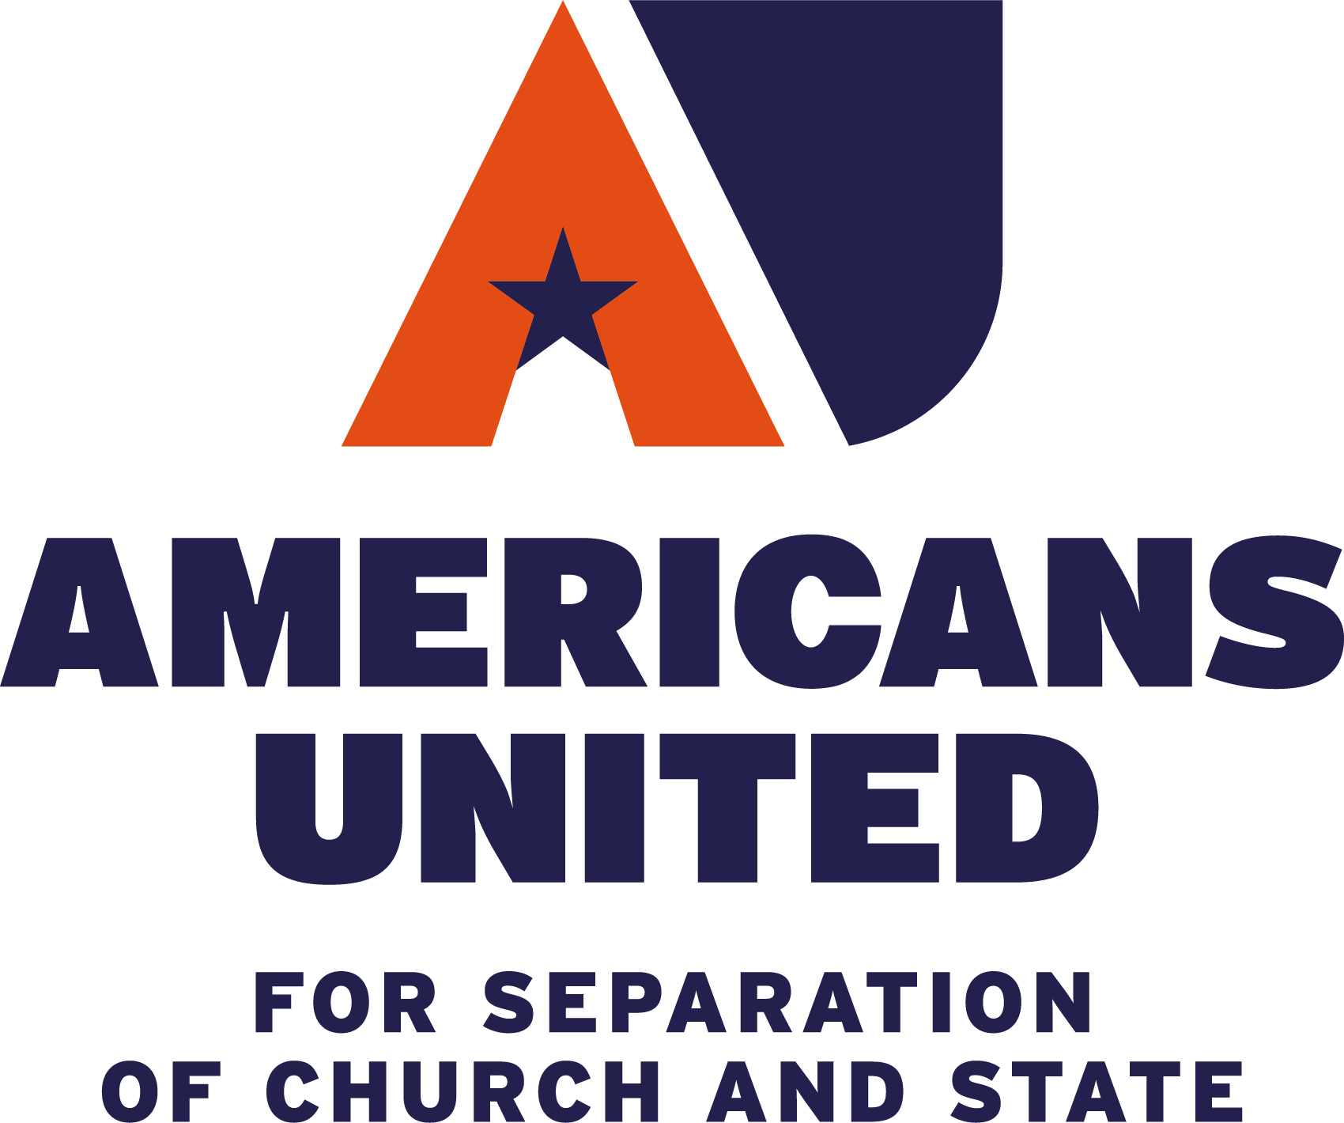

THANK YOU!
Acknowledgement
We extend our thanks to Caroline Mala Corbin, Professor of Law at the University of Miami School of Law, for her insights and feedback in the development of this lesson plan.
Notes:
THIS IS A CLOSING SLIDE. For call to action, sign-off, contact information etc.

