Slide 1
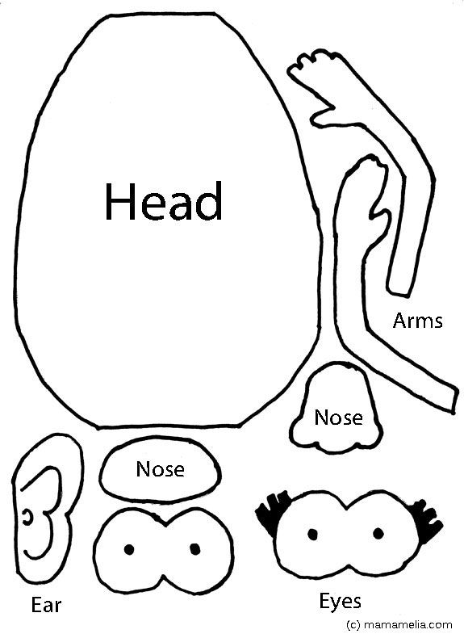
Anatomy of an Op-ed
Garrett Epps, boy journalist
June 12, 2020
ACS Virtual Convention

Slide 2
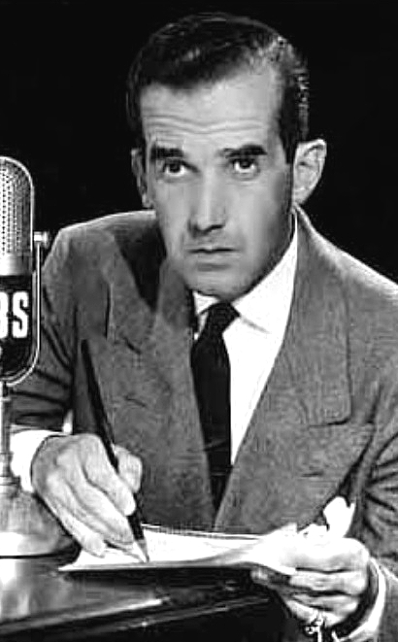
This work matters
Public opinion is formed very quickly on a given issue. You are the voice of progressive legal thought at a moment when it matters.
The prompt appearance of progressive views signals to members of the community that there are like-minded people
Some local media outlets won’t run anything on an issue if you don’t supply it.
Don’t think the op-ed has to be in NYT or WaPo to make a difference. Well reasoned op-eds are also career boosters
Websites, local and national, are looking for interesting content.
Research them
Well reasoned op-eds are also career boosters
“This is a big story and you’re part of it. Keep those lights on,. America.”

Slide 3
First things to remember when writing or pitching: you will be doing good, necessary work for which you are eminently qualified.
Your opinion matters, regardless of your “credentials.” There are many kinds of knowledge you can draw on.
Don’t adopt the credentialist deference that law school inculcates. You, whatever your level in legal education or practice, matter and your opinion should matter to readers and will if clearly presented
Don’t apologize for what you believe.
We are right and they are wrong.
Look around. We are on the move. The other side has lost their stranglehold on the narrative.
Law school discourse discourages passion. Rediscover it.
And remember:

Slide 4

Don’t be apologetic, don’t be intimidate, don’t be afraid. We are the ones who knock
No apology. No surrender.
Not one step back.

Slide 5
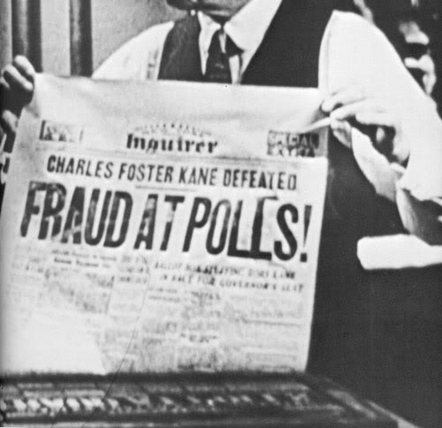
Writing and selling an op-ed
Timely
Specific
Original
Complete
Correct
Research
Length
Proofread
Documented
Clear
Consistent
Formatted for the outlet
You’re dealing with people whose world moves very fast and who are a little put off by lawyers.

Slide 6
Parts of an op-ed
Interesting lede
Statement of relevance
Claim of authority
Proleptical analysis
Fair summary of opposition view(s)— specifics
Summary of correct position, with reason why
What should we do (specific)?
Conclusion: Circle back to lede

Slide 7
The lede is crucial
Poor: “The recent controversy over executive nominations by Gov. Kitzhaber raises important questions.”

Slide 8
The lede is crucial
Poor: “The recent controversy over executive nominations by Gov. Kitzhaber raises important questions.”
So-so: “The Republican majority in the Oregon Senate blocked my nomination to the Crime Commission. Here’s why that matters.”

Slide 9
The lede is crucial
Best: “When I read in the newspaper that the Oregon Senate had rejected my Uncle George for the Crime Commission, I was surprised. George has been dead since 1958, and spent his career as lodge secretary of the Richmond Elks. Only later did I realized they had my name wrong, and had voted me down without even knowing who I am.”

Slide 10
Statement of relevance
Why am I reading about this today?
“In hearings before the Senate Judiciary Committee last week, witnesses identified the nominee, William Rehnquist, as the man they saw harassing black and Hispanic voters, demanding that they read from a card to prove their literacy, asking to see documents that proved they had the right to vote. One witness described a shoving match in which Rehnquist allegedly took part.”

Slide 11
Claim of authority
Why should you care what I think?
This may be the most important single thing in selling an op-ed. Don’t aggrandize youself, but don’t apologize either.
Personal experience (“ I grew up a few blocks from the Lee Monument in Richmond” or “I spent four playing basketball with the Stonewall Jackson High School Raiders in Manassas, Va. ….”)
Academic expertise (“As historian who studies the history of the South, I know that the Lee Monument was erected for a purpose….”)
Professional expertise (“As a lawyer for a civic group, I heard the testimony in the recent statuary lawsuit, and I have realized how ….”)

Slide 12
Rhetorical authority
Why should you care what I think?
Logos—I make a good honest argument based on facts
Ethos—I am a serious, open-minded, and honest thinker
Pathos—these issues seem abstruse—but I feel strongly about them and so should you

Slide 13
Once you’ve made it, live up to it
Do your research. Don’t just read one article. Read as much as you can
Fact-check every factual statement you make, major or minor; even the ones that seem obvious can go awry
Consult the original sources (government reports etc.) where possible
This is timely but the Internet has made this the golden age of research.

Slide 14
The ethos is made by fairness and proleptical argument
Set out your argument in calm, non-polemical language
Fairly and non-polemically set out the other side
Do not sneer, belittle, use derogatory nicknames, or take cheap shots. The people you are trying to reach do not like that.
Refute the other sides’ argument fairly

Slide 15
Do not “write like a lawyer”
Explain jargon (”Standing might be called the ‘house on fire’ principle—if the fire isn’t in your house, you don’t have ‘standing’”)
One thought per sentence. Sentences should be shorter than the ones you learned to write in legal writing.
When an idea is novel, complicated, or surprising, signal that you know that
“The idea that the Constitution protects the climate seems like a new idea—but it has a venerable history in areas like natural resources and Federal Indian law.”
“Many people are surprised to learn that the FBI doesn’t investigate ordinary crime, but there’s a reason for that.”
“’Stare decisis’ is a complex term for a relatively simple idea—courts should not flip flop back and forth on given issues; even if judges don’t like precedent, they are usually required to observe it. ”

Slide 16
What should happen now, and how can the reader help? Be specific
Think of specific things that need to happen.
How can your readers help? If Congress needs to act, let them know what they can do.

Slide 17
Conclusion (“tag”)
Outline what readers have learned and where it might lead them
Return to the beginning (“If they can make some kind of liberal menace out of my poor dead Uncle George, they can smear you or anybody else.”)

Slide 18
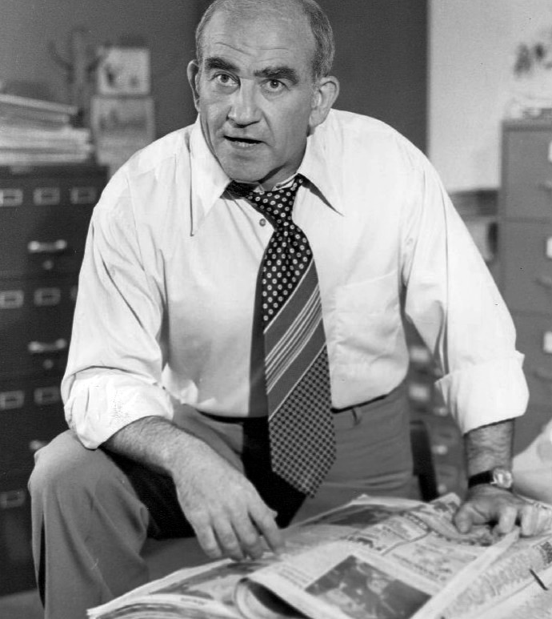
Placing an op-ed
Right away
Submit the entire thing, at the proper length
Study the outlet
Don’t say “you can cut it”
No footnotes, no legal citation, no jargon world
Introduce self
Do you have a name to drop?
Who are you
Why they should buy your piece
Have you published elsewhere?
Explain why this is relevant at this time (Don’t assume the editor knows)
Do not use legal jargon in your pitch.
One outlet at a time—do not do simultaneous submission until you are pretty well known.
Don’t expect quick response or lots of feedback. Editors don’t often ask for rewrites.
“My eyes glaze over.”

