Slide 1
Love Our Constitution | Spring 2020
Notes:
THIS IS THE TITLE SLIDE. You can adjust the point size of the Presentation Name and Date to fit content.

Slide 2
Focus on Article III: The Federal Judiciary
Process Breakdown
Why Focus on the Courts?
Composition of the Courts
Judicial Nominations Process
Notes:
Note to presenter: Identify which district court has jurisdiction over the regions in which the audience members reside.

Slide 3
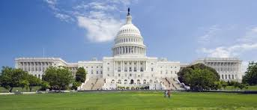
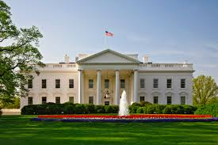
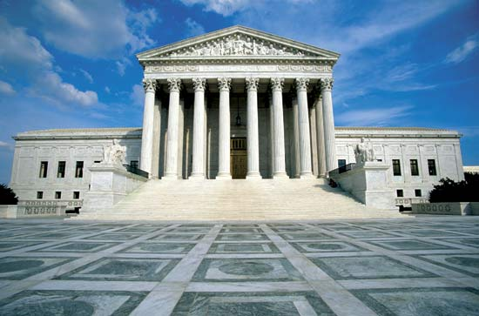
The U.S. Constitution
Article I: Legislative Branch
Designers
Article II: Executive Branch
Article III: Judicial Branch
Implementers
Enforcers
Interpreters
Notes:
resolves crucial questions about how our government operates
provides general framework
intentionally broad

Slide 4
Article III: Judiciary
U.S. Constitution
Article III, Section I
The judicial power of the United States, shall be vested in one Supreme Court, and in such inferior courts as the Congress may from time to time ordain and establish. The judges, both of the supreme and inferior courts, shall hold their offices during good behavior, and shall, at stated times, receive for their services, a compensation, which shall not be diminished during their continuance in office.
Notes:
Article III judges hold their offices during good behavior which has meant that they have lifetime appointments.
Note: there is a debate among some scholars whether federal judges should have terms instead of lifetime appointments. Is this something the Founders would have considered?
The Constitution establishes one Supreme Court, but says “Congress may from time to time ordain and establish” lower courts. Congress has passed legislation to create many lower level courts – known as U.S. District and Circuit Courts of Appeals.
Who can serve on the court(s)
Eligibility: none outlined – no age minimum, no education requirements, etc.

Slide 5
Focus on the Federal Judiciary
Supreme Court
More than 10,000 petitions submitted annually
U.S. Circuit Courts of Appeals
U.S. District Courts
Hears only 75-80 cases
Receive more than 55,600 filings annually
Receive more than 390,500 filings annually
9 seats
179 seats
673 seats

Slide 6
Judicial Nominations Process
How Do Judges Become Judges?
Article II (Executive), Section 2
The President…shall nominate, and by and with the advice and consent of the Senate, shall appoint ambassadors, other public ministers and consuls, judges of the Supreme Court, and all other officers of the United States, whose appointments are not herein otherwise provided for, and which shall be established by law….
Notes:
President nominates – with the advice and consent of the Senate.
This only specifies the Supreme Court judges, but Congress has “established by law” other “Article III” judgeships at the District and Circuit Court levels.

Slide 7
Judicial Nominations Process
Federal Judicial Nominations Process
Judicial Vacancy Announced
Step 1: President Nominates
Step 2: Senate Judiciary Committee Evaluates
Step 3: Senate Judiciary Committee Reports
Step 4: Senate Confirmation Vote
Notes:
There are no time limits at any point of the process.
Given the multiple factors and activities that feed into each of these phases, there are many opportunities for input and significant delays to occur.

Slide 8
Judicial Nominations Process
How Does Advice & Consent Happen?
Pre-Nomination: Home-state Senator Selection, Consultation
Post-Nomination: Blue Slips, Committee Hearings, Committee Vote, Senate Vote

Slide 9
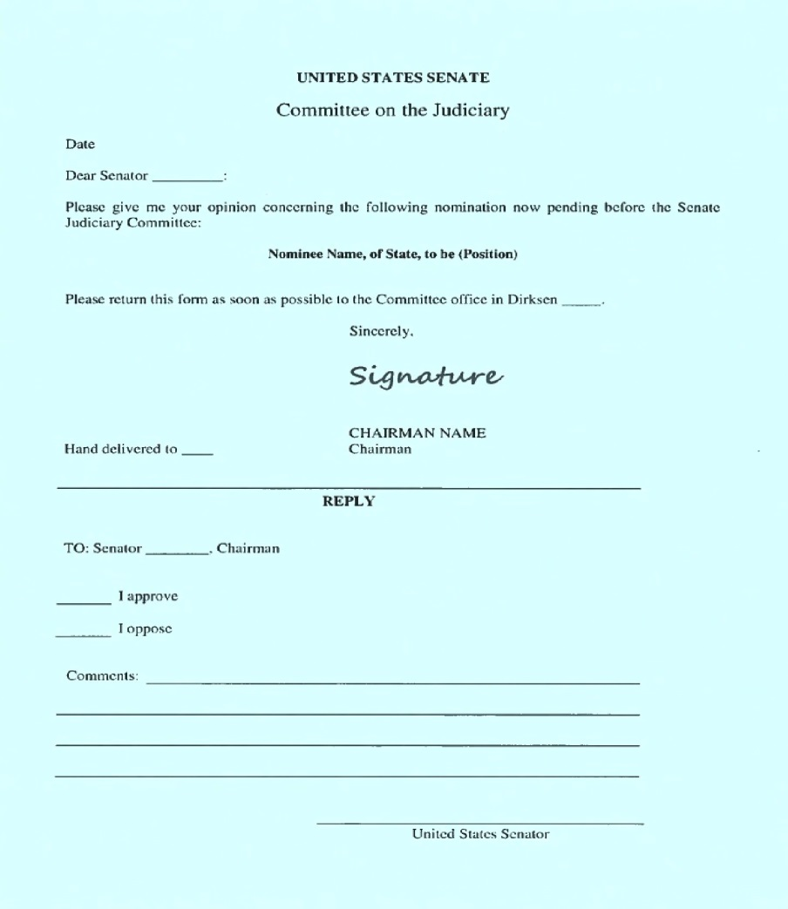
Blue Slips
What is a blue slip?
A blue slip is a norm afforded to home-state senators. Traditionally, this allowed those senators to support or oppose a judicial nominee.
As part of fostering the “advice and consent” of the Senate, this policy tends to promote early consultation between the White House and the nominees’ home-state senators.

Slide 10
Judicial Nominations Process
Changes in Blue Slips
Historically, the lack of a blue slip from a home-state senator would prevent a nominee from advancing in the nomination process.
Under Chairmen Grassley & Graham the Senate Judiciary Committee is no longer considering blue slips for circuit court nominees. Numerous nominees have advanced without receiving one, including Michael Brennan (7th Cir.), Daniel Collins (9th Cir.), and Steven Menashi (2d Cir.).
Chairman Graham does still recognize the blue slips for district court nominees. As recently as Sept. 2019, a nominee withdrew after not receiving a blue slip from Sen. Gillibrand.
Notes:
For lower court nominations, the Senate Judiciary Committee maintains a “blue slip” policy. This policy means that a senator, regardless of his/her party affiliation, is provided the courtesy of submitting a “blue slip” to signal support of a nominee from his/her state.
A senator opposed to a particular judicial nominee from her/his home state may decline to return a positive blue slip to the Committee or s/he may return a negative blue slip which would block the nominee from receiving a committee hearing or vote. Historically, the lack of a blue slip would prevent a nominee from advancing in the process, effectively ending the nomination. Recently, the SJC during the Trump administration has ignored blue slips for circuit court nominees, advancing numerous circuit court noms out of committee that did not have returned blue slips. The SJC has mostly maintained blue slips for district court noms.
As part of fostering the “advice and consent” of the Senate, this policy tends to promote early consultation between the White House and the nominees’ home-state senators.

Slide 11
Judicial Nominations Process
Nearly 10% of federal judgeships are currently vacant or will be soon.
As of January 9, 2020, there are:
73 Current Vacancies
11 Known Future Vacancies

Slide 12
Process Breakdown
187 Confirmations
2 Supreme Court Justices
33 Pending Nominations*
2 Circuit Court Nominees
30 District Court Nominees
51 More Vacancies Waiting for Nominees
0 Circuit Court Vacancies
50 Circuit Court of Appeals Judges
133 District Court Judges
50 District Court Vacancies
1 Court of International Trade
2 Court of International Trade Judges
1 Court of International Trade
As of January 9, 2020
*includes those nominees waiting to be re-nominated

Slide 13
Process Breakdown
In 2016, the Senate Republican Majority refused to consider Chief Judge Merrick Garland’s nomination to the U.S. Supreme Court.
They also refused to process nominees to fill more than 100 lower court vacancies.
During President Obama’s final 2 years, the Senate Republican Majority confirmed the fewest number of judges (22 in 2 years) since the Eisenhower Administration.

Slide 14
Process Breakdown
During the 2016 election, then-candidate Trump promised to:
Transform the judiciary
Nominate individuals who would overturn Roe v. Wade and expand the Second Amendment

Slide 15
Process Breakdown
Refusing to consider and holding open the seat of a Supreme Court nominee for over a year
Lack of consultation with home-state Senators, ignoring blue slips
White House refusal to allow the ABA Standing Committee on the Federal Judiciary to review nominees before nominees are officially nominated
Incomplete vetting of nominees
Stacking committee hearings

Slide 16
Process Breakdown
Trends in Nominees:
More “Not Qualified” Ratings from the ABA Standing Committee on Federal Judiciary
9 “Not Qualified” nominees under this administration v. 0 during the Obama administration
Lack of legal experience
No practice in the level of court to which they’re being nominated
Writings, blogs, and speeches show evidence of discriminatory animus

Slide 17
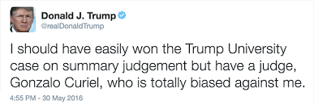
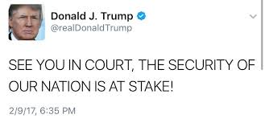
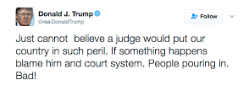
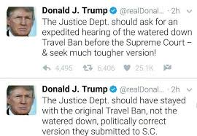
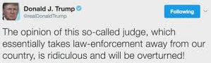
Process Breakdown
The President’s statements about judges and the judiciary have raised concerns about his commitment to core constitutional values and rule of law.
Notes:
The President has certainly interjected conversation about judges and the judiciary in his own comments.
Throughout his campaign and since his election, the President repeatedly emphasized that his Supreme Court nominee would be the most conservative jurist he could find, and he made sure his nominee passed a series of litmus tests, including on reproductive rights and gun safety laws.
And yet, we have a President who is undermining and attacking the courts.
Judge Gonzalo Curiel, who presided over a case involving Trump University, was called a “total disgrace” because he was a Mexican-American. Judge James Robart, who halted Trump’s Muslim ban, was labelled a “so-called judge.”
Attorney General Sessions also piled on when he said “I really am amazed that a judge sitting on an island in the Pacific can issue an order that stops the president of the United States from what appears to be clearly his statutory and constitutional power.”

Slide 18



Why Focus on the Courts? What Issues Do You Care About?
Immigration
Anti-Discrimination
Voting Rights
Reproductive Health Care Access
Criminal Justice

Slide 19
Why Focus on the Courts?
Immigration
Trump v. Hawaii (2018)
Anti-Discrimination
Masterpiece Cakeshop v. Colorado Civil Rights Commission (2018)
Department of Commerce v. New York (2019)
Zarda v. Altitude Express (2d Cir., 2018)
EEOC v. R.G. & G.R. Harris Funeral Homes Inc. (6th Cir., 2018)
Voting Rights
Criminal Justice
Reproductive Health
Care Access
Husted v. A. Philip Randolph Institute (2018)
Rucho v. Common Cause (2019)
Carpenter v. United States (2017)
Bucklew v. Precythe (2019)
June Medical Services v. Gee (5th Cir. 2019)
Garza v. Hargan (D.C. Cir., 2017)

Slide 20
Process Breakdown

Slide 21
How Can You Help Change These Trends?
Talk to your Senators and VOTE!
The President and your Senators are the key players in selecting and confirming judges
Vote for candidates who support qualified and diverse judges
Register to vote
Adult registration information available at https://www.rockthevote.org/register-to-vote/
Pre-registration information for teens available at http://www.ncsl.org/research/elections-and-campaigns/preregistration-for-young-voters.aspx

Slide 22
Resources
Learn more about…
The American Constitution Society, constitutional issues and news: www.acslaw.org
Judicial vacancies and nominations: www.judicialnominations.org
U.S. Constitution’s origins: constitutionalrights.constitutioncenter.org/
Other countries’ constitutions: www.constituteproject.org/
U.S. Courts (History, Authorizations, Judges, Vacancies, etc.): www.uscourts.gov
U.S. Senate Judiciary Committee: www.judiciary.senate.gov

Slide 23
Love Our Constitution
Notes:
THIS IS THE DIVIDER OR SUBTITLE SLIDE to use in between a series of slides

Slide 24
THANK YOU
Notes:
THIS IS A CLOSING SLIDE. For call to action, sign-off, contact information etc.

